Slide 1
BI Tableau Project Report
(Global Superstore - Dashboard)
Gaurav Vijay Topre

Slide 2
Index
About Dataset
Problem Statements
Dashboard
Analysis / Conclusion
Video link & File Link

Slide 3

About Dataset
The dataset used for creating this Dashboard was taken from kaggle and it is about categorical sales of products throughout the globe, link for downloading the dataset is given below
Click to Download Dataset : - https://bit.ly/3pbF2Bp
This dataset was clean so there was no need of cleaning the
Data before dashboarding.

Slide 4
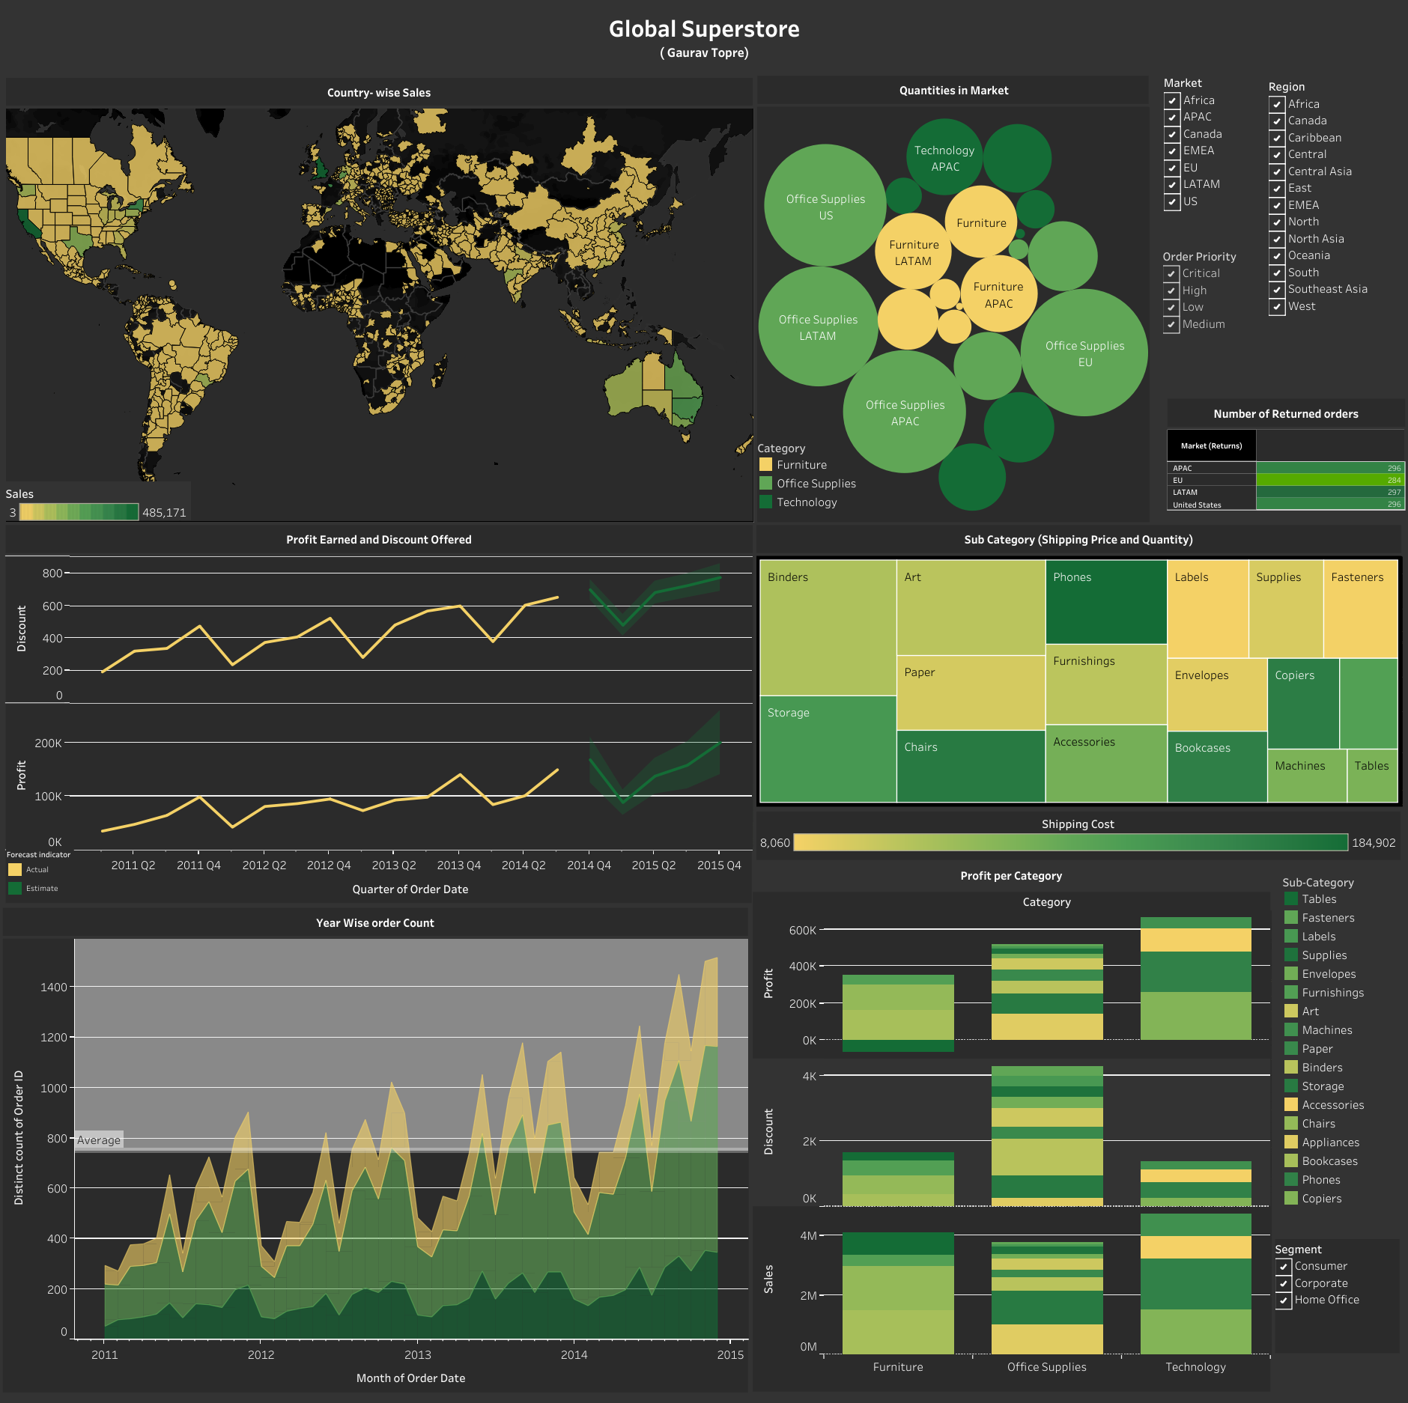
Main Characters
Tableau Dashboard
Tableau Dashboard

Slide 5
Problem Statements
Country with highest sales ?
No.of Returned Products (Market wise) ?
Sub Categorical analysis of shipping price and quantities sold ?
Monthly Order placed and Average No.of orders / month ?
Trends in profit earned on quarterly basis ?
Trends in Discount offered on quarterly basis ?
Categorical Relation between sales, profit and Discount offered ?
Quantities sold in various markets ?
Shipping price for sub- categories?
No. of Orders / Region ?

Slide 6
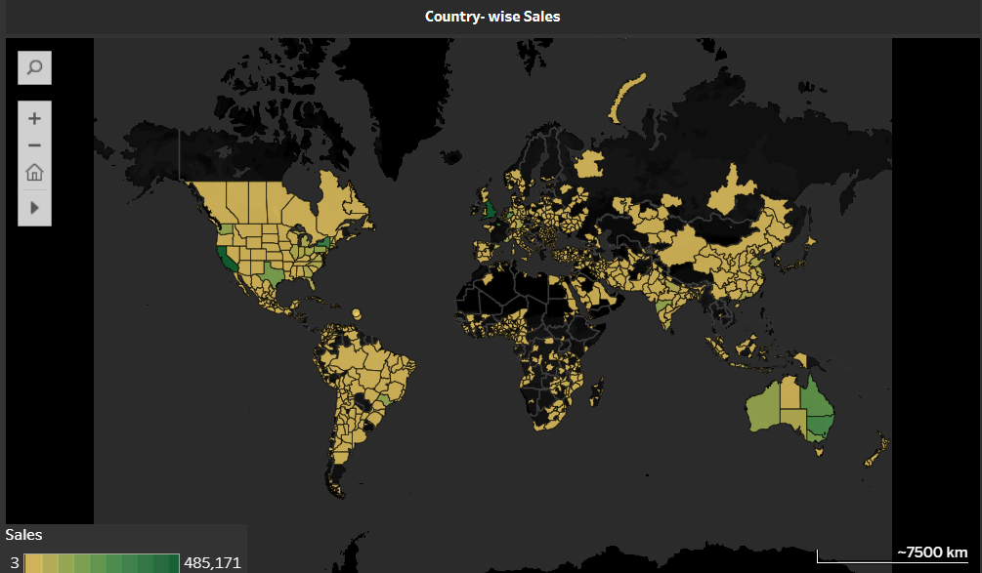
Country (state) with Maximum Sales ?
Maximum number of Sales we are observing in England , United Kingdom. Second Highest sales are in California state of US

Slide 7
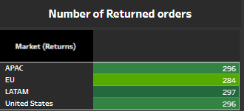
Number of Returned Product (Market-wise) ?
There are total 1,173 products which are returned out of which maximum(297) are from LATAM market and minimum(284) are from EU market.

Slide 8
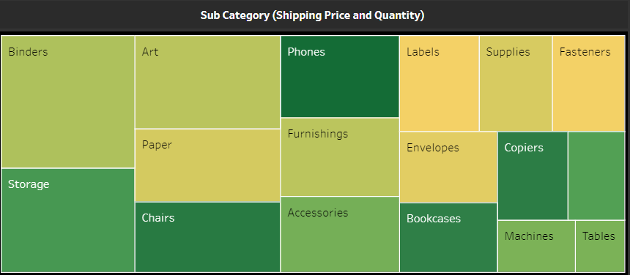
Sub-Categorical Analysis of Quantities sold and Shipping Price ?
Maximum quantities are of BLINDERS (21,429) and Minimum are of TABLES (3,083).
Maximum Shipping Price is for PHONES(1,84902) and Minimum is for LABELS (8060)

Slide 9
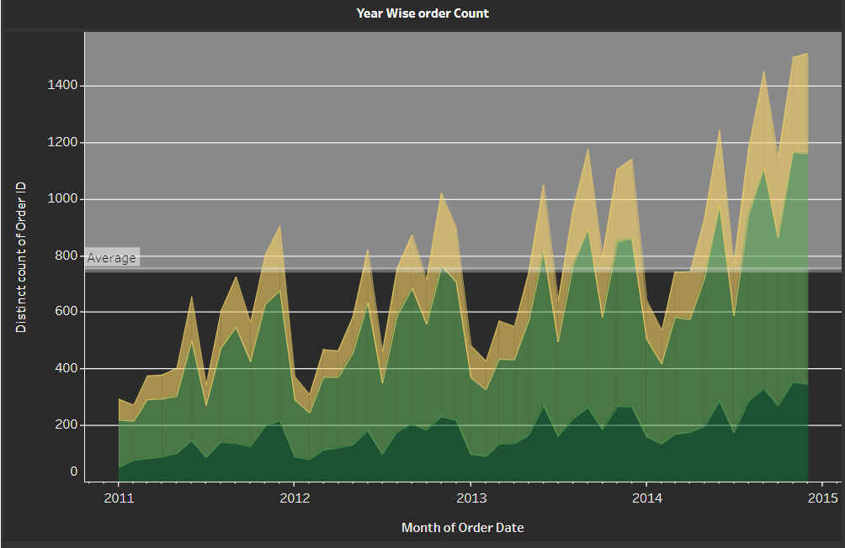
Monthly orders and average number of orders per Month for the listed Duration ?
Yearly order count is showing Positive Trend and Average number of orders per year are approx 752.

Slide 10
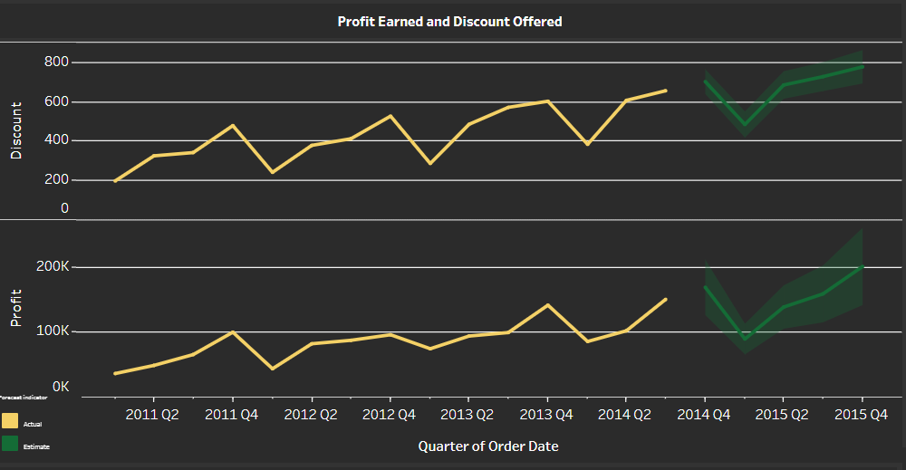
Trends in profit Earned and Discount Offered ?
Maximum profit(1,49,558) was earned in Q3 of 2014 whereas minimum(36,043) was in Q1 of 2011.
Maximum Discount(653.3) was offered in Q3 of 2014 whereas minimum(195.2) was in Q1 of 2011.

Slide 11
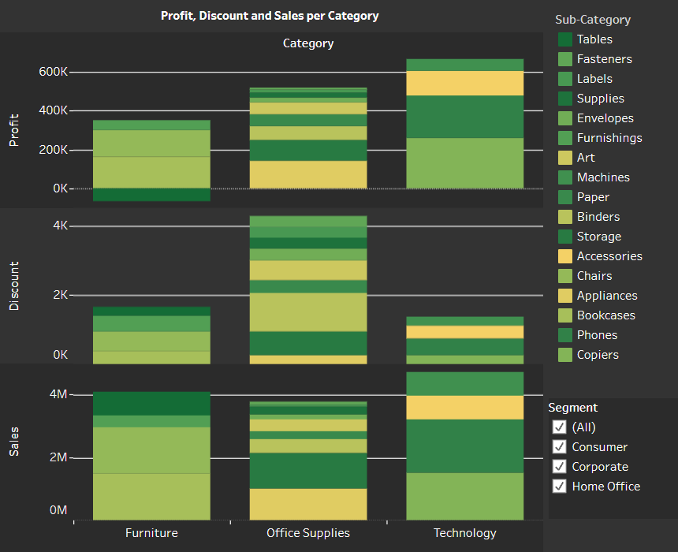
Categorical Relation Between Profit, Discount and sales ?
Maximum Profit and sales were observed in TECHNOLOGY whereas Maximum Discount is offered for OFFICE SUPPLIES.
Maximum Discount(653.3) was offered in Q3 of 2014 whereas minimum(195.2) was in Q1 of 2011.

Slide 12
Analysis
Maximum Quantities of Office supplies were sold in EU Market, of Furniture were in LATAM Market and of were Technology were in APAC Market.
Phones are having Max Shipping Price whereas Labels are having Min.
Maximum Orders (11,117) are from Central Region and Minimum (384) are from Canada Region.

Slide 13
Conclusions
Phones are having relatively less number of quantities still their shipping price is Highest (considering the safety measures).
Every-year it is seen that profit jumps to its peak in Q3 and dips down in Q1 this is because of the Discount offered in these quarters (more the discount more is the profit).
Till october 2011 number of order placed per month were less than that of avg.no of orders and after April 2014 every month the no.of orders are above average.

Slide 14
Video Link
Dashboard Link
Click Here to Download the Video
Click Here to See Dashboard

Slide 15
Thank You !

